Slide 1

Computer Architecture
CS-211
Spring 2017 | Recitation
Abu Shoeb

Slide 2
Hello!
Full Name : Abu Awal Md Shoeb
You can call me Shoeb
Email : as2352@scarletmail.rutgers.edu
Office : Hill 264A
Hours: Tuesdays 12pm – 1pm
Use Sakai Forums for any queries. However, if you need to send an email to your TA then please use CS-211 as prefix in your Email Subject!
Notes:
<number>

Slide 3
Agenda
Introduction
How to use iLab machines
Useful Linux Commands
How to write and compile C programs

Slide 4
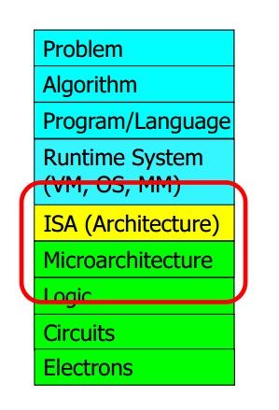
Introduction
Source : Computer Architecture by Onur Mutlu from Carnegie Melon University
Notes:
<number>

Slide 5
Connect to iLab servers
Follow the link to open your account now http://www.cs.rutgers.edu/resources/systems/ilab/
To get connected with iLab machines
Use X2GO client for GUI
Windows : download and install
Linux : sudo apt-get install x2goclient
Or use Terminal/Command Line application
ssh netid@address
eg. ssh shoeb@builder.cs.rutgers.edu
You can also use Putty/WinSCP on Windows

Slide 6
Write/Edit Your Code
Edit your code using
Graphical User Interface
Gedit
Notepad++(Windows)
Geany(Linux)
Command Line
Gedit/Nano/Vim
Vim Commands
Type vim filename (eg. vim welcome.c)
Press “a” to append “i” to insert text
Press ESC for command
Type :q! (quit without saving)
Type :wq (write and quit)

Slide 7
Basic Linux Commands 1
Check this: http://linuxcommand.org/index.php
ssh: login to any machines remotely
pwd: show current location
cd: change directory (eg. $cd Documents, or $ cd ..)
ls: list all contents (http://www.rapidtables.com/code/linux/ls.htm)
locate: show location of a file (eg. $locate test.txt)
Grep: search texts in files (http://www.cyberciti.biz/faq/howto-use-grep-command-in-linux-unix/)
--version: show version (eg. $ java –version)
cat: print contents on screen (ex. $ cat test.txt)
touch: create a file (eg. $ touch test.txt)
nano, vim: editor (eg. $ nano test.txt)
Notes:
<number>

Slide 8
Basic Linux Commands 2
cp: copy file (eg. $ cp source.txt destination.txt)
mkdir: make directory (eg. $ mkdir myfolder)
rm: remove file (eg. $ rm test.txt)
mv: rename file (eg. $ mv oldname.txt newname.txt)
scp: transfer file from local to server machine and vice versa (scp sourcce destination)
Local computer to iLab
$ scp -r local-folder/ shoeb@null.cs.rutgers.edu:~/
iLab to Local (execute command from local machine)
$ scp -r shoeb@null.cs.rutgers.edu:~/remote-folder/ /home/shoeb/
Notes:
<number>

Slide 9
Compile and Run C Code
Create a .c file (eg. $ touch hello.c)
Open the file with gedit/vim/nano
Compile your code
$ gcc -Wall -Werror -fsanitize=address hello.c -o hello.out
Run your code
$ ./hello.out
Notes:
<number>

Slide 10
Assignment For This Recitation!
Nothing :-)

